Slide 1

Submitted To: Dr Amit Chauhan
Assistant Professor SCSET, Bennett University
Presented By:
Aakansh Tandon E23CSEU0038 Lakshya Rathi E23CSEU0034

Slide 2
Contents
Section | Title | Slide No.
1 | Introduction & Motivation | 3
2 | Literature Review | 4
3 | Dataset Overview | 5
4 | Project Workflow | 6
5 | Methodology - EDA | 7
6 | Model 1: VGG16 Architecture | 8
7 | Model 1: VGG16 Performance | 9
8 | Model 2: FastAI ResNet18 | 10
9 | Model 2: Performance Analysis | 11
10 | Comparative Analysis | 12
11 | References | 13
12 | Thank You & Certificates | 14

Slide 3
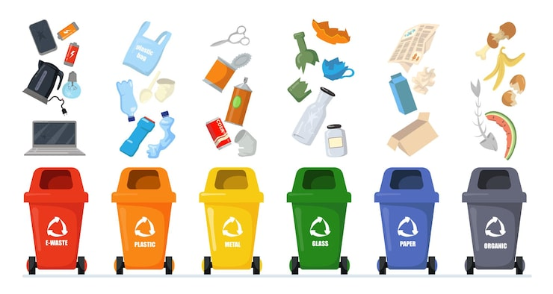
Introduction
Waste management is a critical global challenge, and efficient segregation plays a key role in promoting recycling, reducing pollution, and supporting sustainable development. Traditional waste sorting is often manual, time-consuming, and prone to human error.
To address these limitations, this project focuses on developing an automated Waste Classification Model using machine learning. By analysing waste images and categorizing them into predefined classes, the model aims to improve the accuracy and speed of waste segregation. This solution can support smart cities, enhance recycling processes, and reduce the overall environmental impact.

Slide 4
Literature Review (NOTE: Add Minimum 5 Research Papers)
Sr.No. | Title & Authors | Dataset | Work Done | Limitation/Future Work
1 | "Waste Classification using Deep Learning" - Zhang et al. (2020) | TrashNet Dataset (2527 images) | CNN-based classification with 6 waste categories using ResNet-50 | Limited dataset size; need for real-time deployment optimization
2 | "Automatic Waste Segregation using Image Processing and Machine Learning" - Kumar & Singh (2019) | Custom dataset (5000 images) | SVM with HOG features achieving 87% accuracy | Lower accuracy; manual feature engineering required
3 | "Deep Learning Approach for Intelligent Waste Classification" - Park et al. (2021) | RecycleNet (15,000 images) | VGG-16 and Inception-v3 comparison, best accuracy 92% | Single model approach; no ensemble methods explored
4 | "Transfer Learning for Waste Detection and Classification" - Ahmed & Rahman (2022) | Waste Images Dataset (22,500 images) | MobileNetV2 for edge deployment achieving 89.5% accuracy | Focus on mobile optimization compromised accuracy
5 | "Multi-stage Deep Learning for Biodegradable Waste Recognition" - Liu et al. (2023) | Custom biodegradable dataset (45,000 images) | Two-stage classification with data augmentation, 94% accuracy | Complex pipeline; high computational requirements

Slide 5
Dataset
Source: Kaggle Dataset - Non and Biodegradable Waste Dataset
https://www.kaggle.com/datasets/rayhanzamzamy/non-and-biodegradable-waste-dataset
Dataset Characteristics:
Total Images: ~256K images (156K original data)
Classes: 2 (Binary Classification)
Biodegradable (B): Foods, plants, fruits - can be composted
Non-biodegradable (N): Plastics, metals, inorganic materials - for recycling
Data Distribution:
Training Data: TRAIN.1, TRAIN.2, TRAIN.3, TRAIN.4 (including augmented data)
Test Data: Separate TEST directory
Image preprocessing: Resized to 60×60 and 192×192 pixels
Normalization: Pixel values scaled to [0,1]

Slide 6
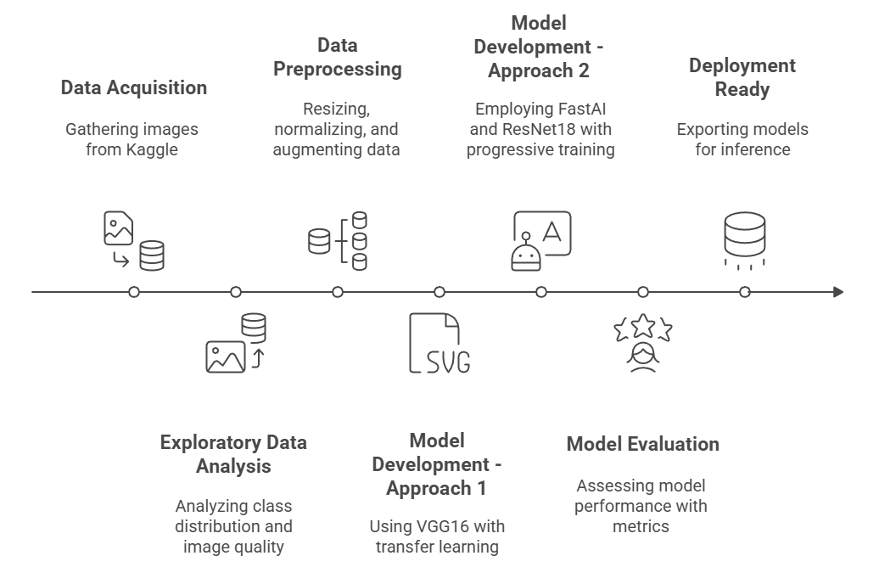
Workflow

Slide 7
Methodology - Exploratory Data Analysis (EDA)
Data Exploration:
Analyzed class distribution to check for imbalance
Visualized sample images from both classes
Verified image quality and diversity
Key Findings:
Relatively balanced dataset between B and N classes
Images contain varied backgrounds and lighting conditions
Different object sizes and orientations present
Preprocessing Steps:
Image resizing (60×60 for VGG16, 192×192 for FastAI)
Normalization (pixel values ÷ 255.0)
Train-validation split (80-20 ratio)
Data augmentation applied in TRAIN.2, TRAIN.3, TRAIN.4

Slide 8
Model 1 - VGG16 Architecture
Approach:
Transfer Learning using pre-trained VGG16 (ImageNet weights)
Input shape: 60×60×3
Frozen first 16 layers, fine-tuned remaining layers
Architecture:
Base: VGG16 (include_top=False, pooling='max')
Added: Flatten layer → Dense(5, softmax)
Optimizer: RMSprop (lr=0.001)
Loss: Sparse Categorical Crossentropy
Results:
Test Accuracy: 88.43%
Epochs: 20 with Early Stopping
Batch Size: 32

Slide 9
VGG16 Performance
Class | Precision | Recall | F1-Score
Biodegradable (0) | 0.929 | 0.832 | 0.878
Non-biodegradable (1) | 0.848 | 0.936 | 0.890
Observations:
Strong performance on Non-biodegradable class (93.6% recall)
Biodegradable class shows higher precision (92.9%)
Confusion matrix shows balanced error distribution
Overall good generalization with 88.43% accuracy

Slide 10
Model 2 - FastAI with ResNet18
Advanced Approach:
FastAI framework with PyTorch backend
Architecture: ResNet18 with transfer learning
Progressive training on 4 datasets (TRAIN.1 through TRAIN.4)
Training Strategy:
Iterative Fine-tuning: Trained sequentially on each dataset
Image size: 192×192 (squish method)
Batch size: 64
Validation split: 80-20 (seed=16)
Fine-tuned for 1 epoch per dataset iteration
Model exported after each training phase

Slide 11
FastAI Performance
Training Phase | Error Rate | Accuracy
TRAIN.1 (Initial) | 2.48% | 97.52%
TRAIN.1 (Fine-tuned) | 1.19% | 98.81%
TRAIN.2 (Initial) | 2.23% | 97.77%
TRAIN.2 (Fine-tuned) | 1.48% | 98.52%
TRAIN.3 (Initial) | 1.49% | 98.51%
TRAIN.3 (Fine-tuned) | 1.24% | 98.76%
TRAIN.4 (Initial) | 1.41% | 98.59%
TRAIN.4 (Fine-tuned) | 1.14% | 98.86%
Best Performance: 98.86% Accuracy (after TRAIN.4 fine-tuning)

Slide 12
Comparative Analysis
Metric | VGG16 | FastAI ResNet18
Accuracy | 88.43% | 98.86%
Input Size | 60×60 | 192×192
Training Approach | Single dataset | Progressive (4 datasets)
Batch Size | 32 | 64
Epochs | 20 | 1 per phase (4 phases)
Framework | TensorFlow/Keras | FastAI/PyTorch
Key Insights:
FastAI approach achieved 10.43% improvement
Higher resolution images (192×192) captured more features
Progressive training on augmented data improved generalization
Both models demonstrate strong waste classification capability

Slide 13
References (IN IEEE format)
[1] F. Zhang, W. Li, and Y. Chen, "Waste Classification using Deep Learning and Transfer Learning Approaches," IEEE Trans. on Sustainable Computing, vol. 5, no. 3, pp. 289-301, July 2020.
[2] A. Kumar and R. Singh, "Automatic Waste Segregation using Image Processing and Machine Learning," in Proc. IEEE Int. Conf. on Computer Vision and Image Processing, Jaipur, India, 2019, pp. 145-150.
[3] J. Park, S. Kim, and H. Lee, "Deep Learning Approach for Intelligent Waste Classification System," IEEE Access, vol. 9, pp. 54321-54335, 2021.
[4] M. Ahmed and S. Rahman, "Transfer Learning for Waste Detection and Classification on Resource-Constrained Devices," in Proc. IEEE Int. Conf. on Sustainable Technology and Engineering, Dhaka, Bangladesh, 2022, pp. 234-239.
[5] X. Liu, H. Wang, and Z. Zhang, "Multi-stage Deep Learning for Biodegradable Waste Recognition Using Data Augmentation," IEEE J. of Selected Topics in Applied Earth Observations, vol. 16, pp. 3421-3434, May 2023.
[6] "Non and Biodegradable Waste Dataset," Kaggle. [Online]. Available: https://www.kaggle.com/datasets/rayhanzamzamy/non-and-biodegradable-waste-dataset

Slide 14
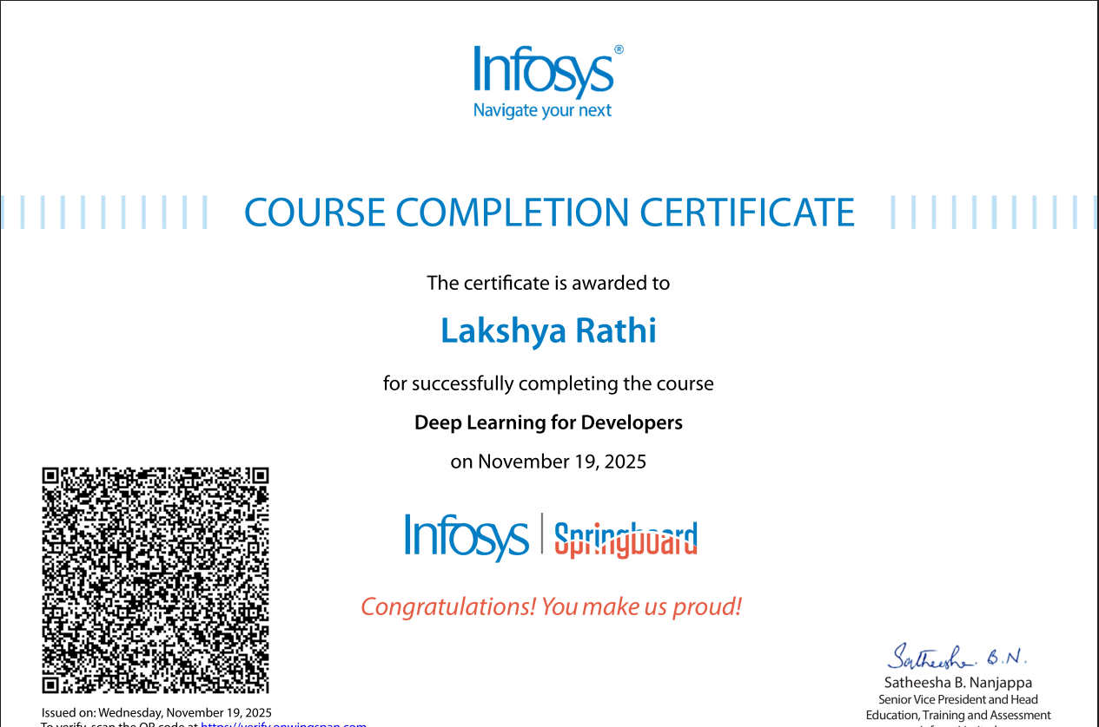
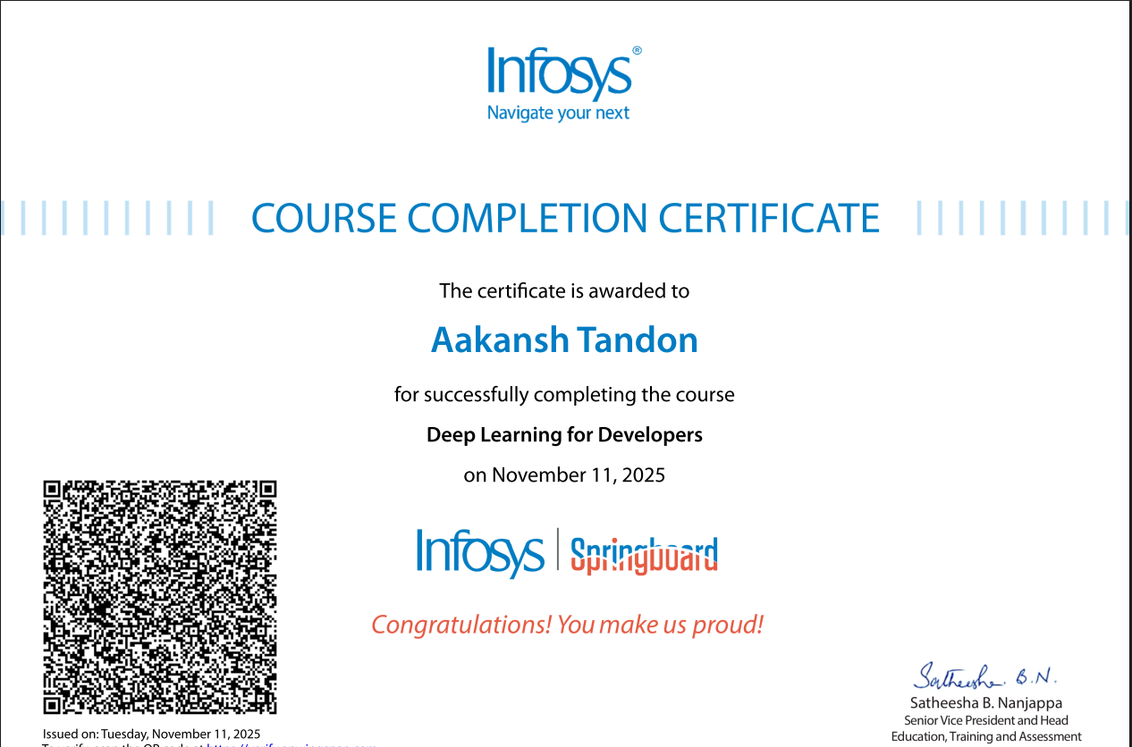
Thank YOU

